Slide 1
BIOPAMA
IUCN’s Global Priorities supporting BIOPAMA
Trevor Sandwith

Slide 2
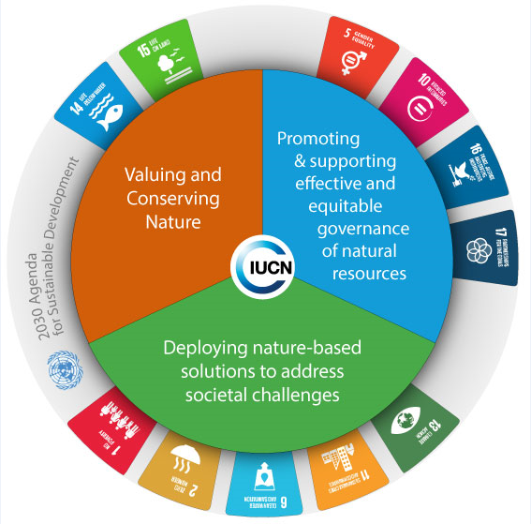

Slide 3
Quality
Capacity
Justice
and equity
Solutions

Slide 5
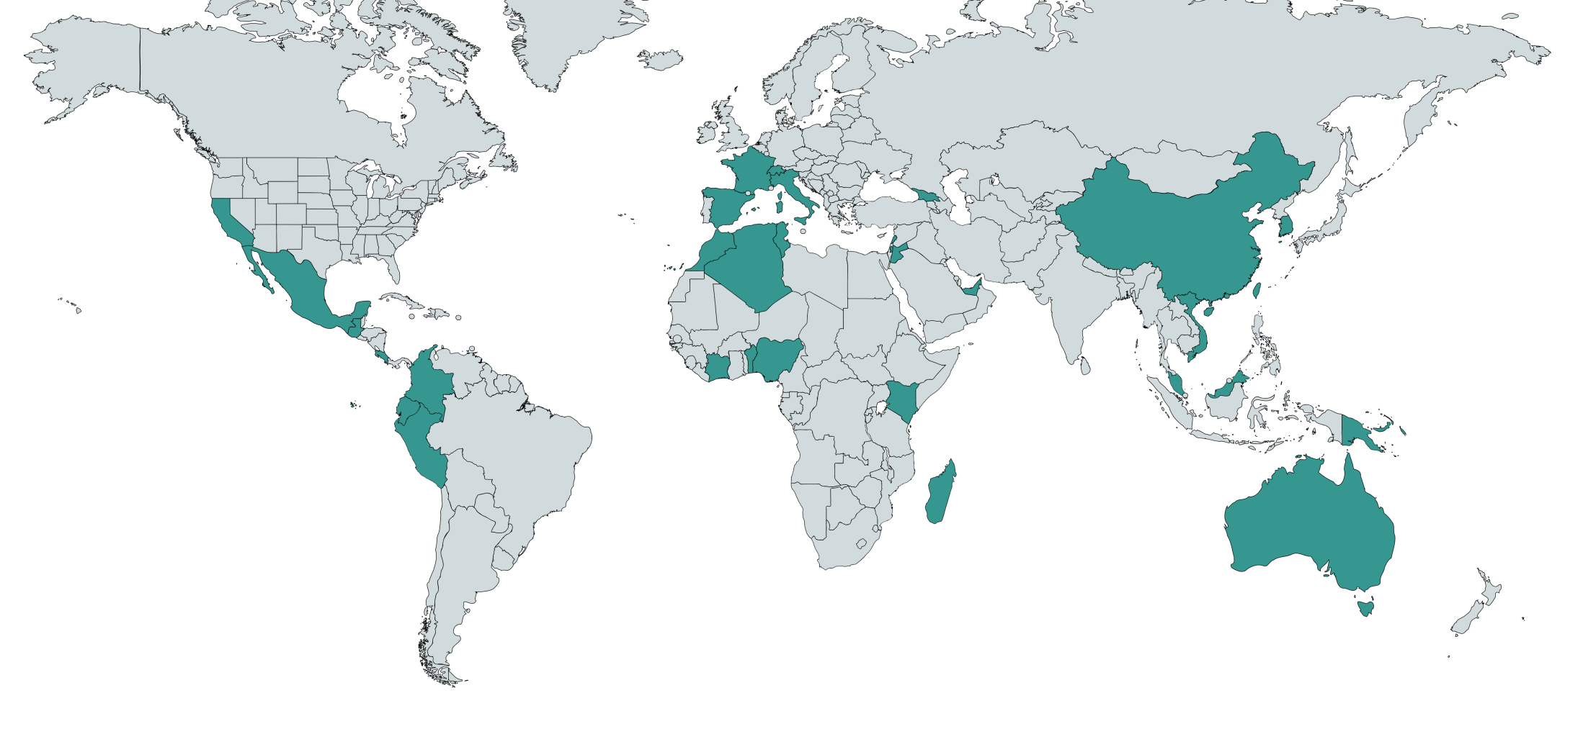
IUCN Green List Partnership
IUCN Green List in 35+ jurisdictions worldwide
Notes:
MAp

Slide 6
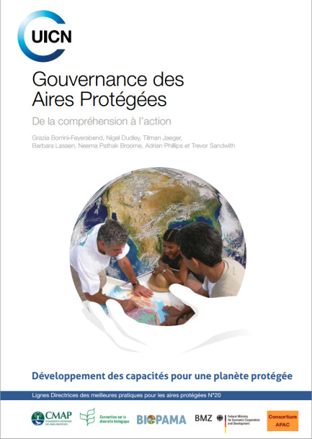

Slide 7
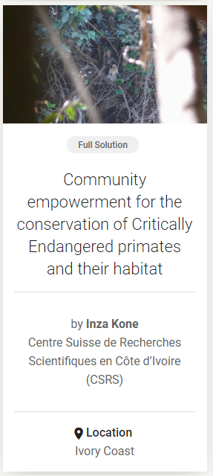
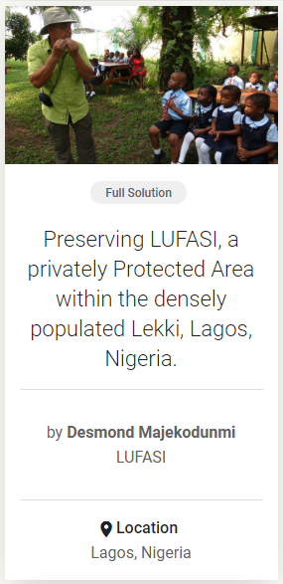
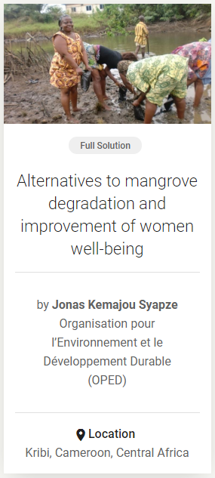

Slide 8
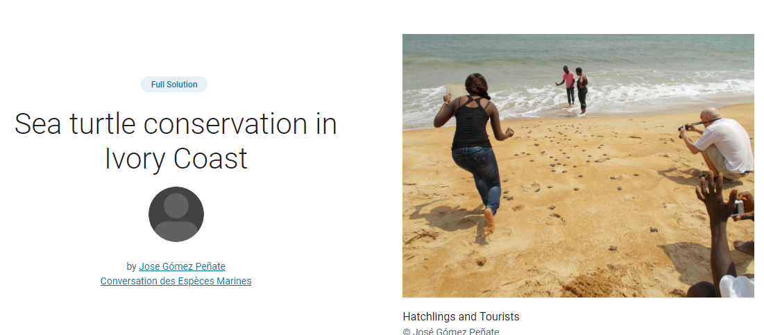

Slide 9
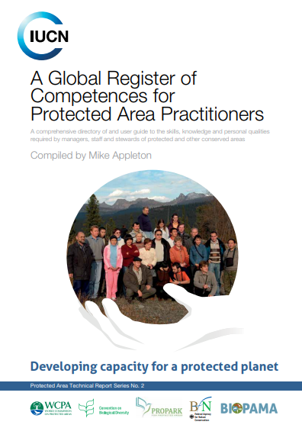
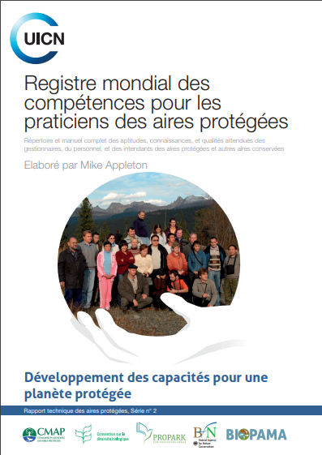

Slide 10
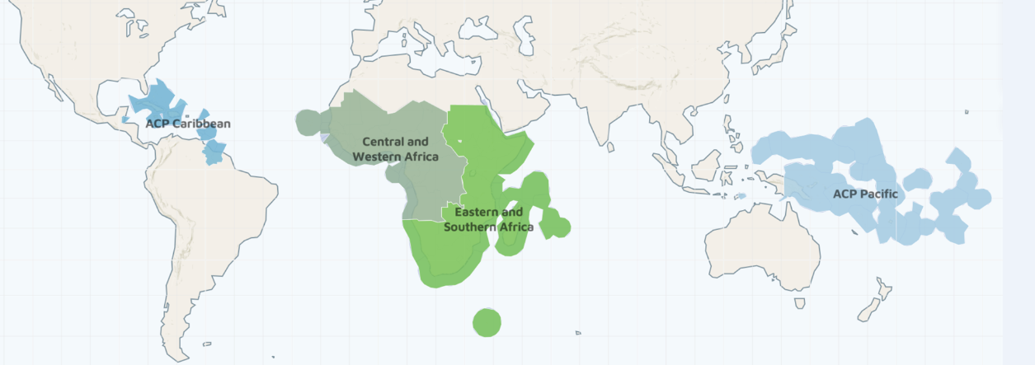
BIOPAMA, the Biodiversity and Protected
Areas Management Programme - Phase II
BIOPAMA in the Africa, Caribbean and Pacific Group of States

Slide 11
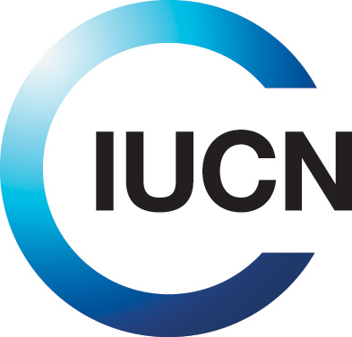
An initiative of the African, Caribbean and Pacific (ACP) Group of States financed by the European Union (EU)’s 11th European Development Fund.
A Global partnership: BIOPAMA combines
the protected areas and the biodiversity conservation expertise of the International Union for Conservation of Nature (IUCN) and
the scientific know how of the Joint Research Centre of the European Commission (JRC).
Close collaboration with the regional, national and local actors in Africa, the Caribbean and the Pacific countries.
A six year programme (2017-2023)
A 60 million Euro investment to improve the long-term conservation and sustainable use of biodiversity and natural resources.
Notes:
Why IUCN: global leader (specialised knowledge based on 70 years+ working on Pas and biodiversity); technical expertise (the largest network of experts – 10K+), institutional presence in ACP; experience in project implementation; synergies with key international conventions.
Why JRC – world-class information systems technology to the challenges of protected areas assessment; working with agencies worldwide
Who we are (BIOPAMA implementation team): based in CH, ACP, Italy (JRC), donors in Brussels, partners worldwide

Slide 12
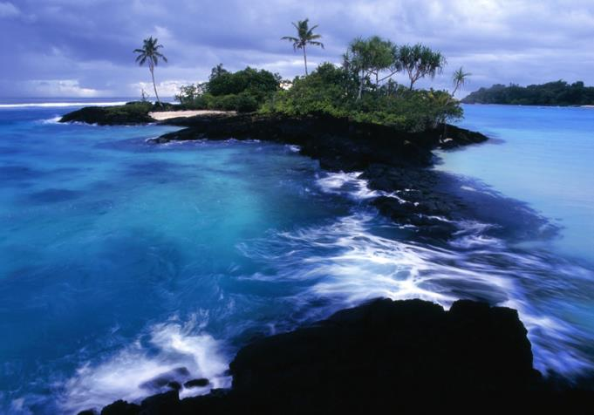
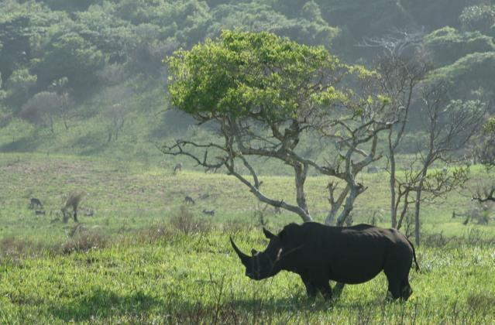
BIOPAMA (2017-2023): the mission
BIOPAMA aims at reinforcing the management and governance of protected and conserved areas in the79 African, Caribbean and Pacific (ACP) countries through better use and monitoring of information and capacity development on management and governance.

Slide 13
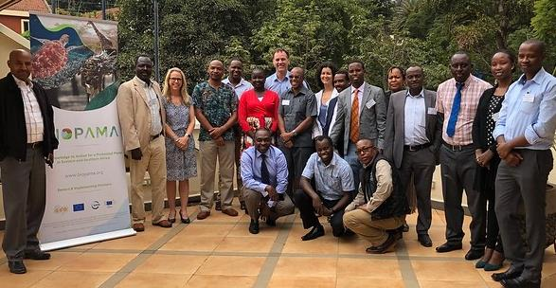
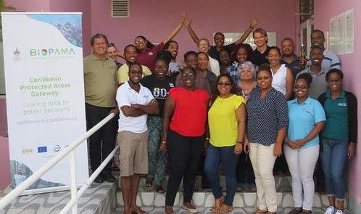
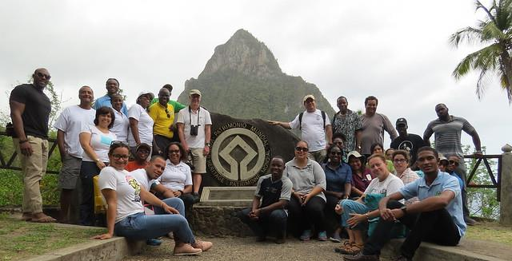
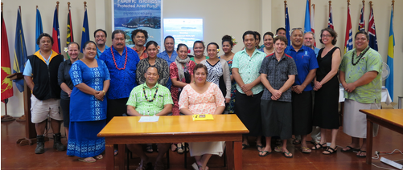
Ministries of Environment and National agencies leading on biodiversity conservation
Protected Area agencies
Regional organizations
Local communities living in and around protected areas
Civil society
Notes:
Tailored support
the protected area actors at the regional, national and local levels, whose efforts will continue to be supported by the provision of tools, services, capacity development and the possibility to finance actions at the site level.

Slide 14
Regional organisations, national and local conservation actors are key partners and beneficiaries.
BIOPAMA aims to complement and align with existing platforms and initiatives.
BIOPAMA is implemented at the regional level through the IUCN Regional Offices in Eastern and Southern Africa, West and Central Africa, Mexico Central America and the Caribbean, and Oceania.
Key regional organizations are partners in the programme’s implementation.
Notes:
The African, Caribbean and Pacific regions represent some of the most challenging places on Earth and host a huge share of our planet’s biodiversity. While the programme’s objectives are the same across all the regions, BIOPAMA can only succeed by tailoring them to respond to specific needs and complement countries’ efforts filling the gaps where they exist.

Slide 15
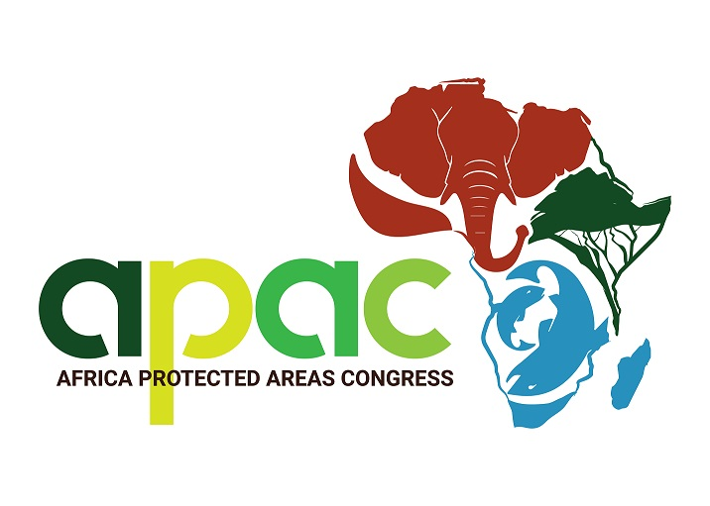
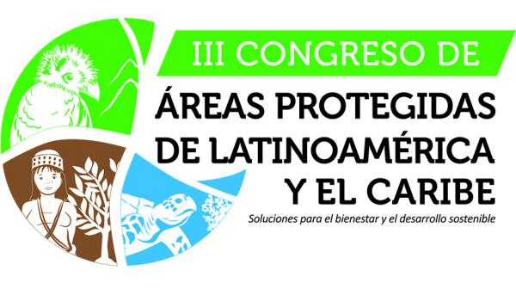
CBD COP 15,
China 2020
10th Pacific Islands Conference on Nature Conservation and Protected Areas
2020
Merci beaucoup. Thank you.
Notes:
29 out of the 79 ACP countries are State members of IUCN

