Slide 1


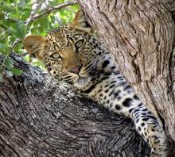
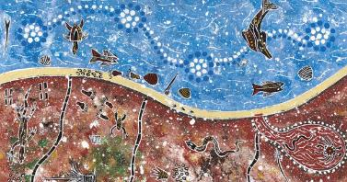


Standards for Protected and Conserved Areas
IUCN Global Protected Areas Programme
June 2019
greenlist@iucn.org

Slide 2
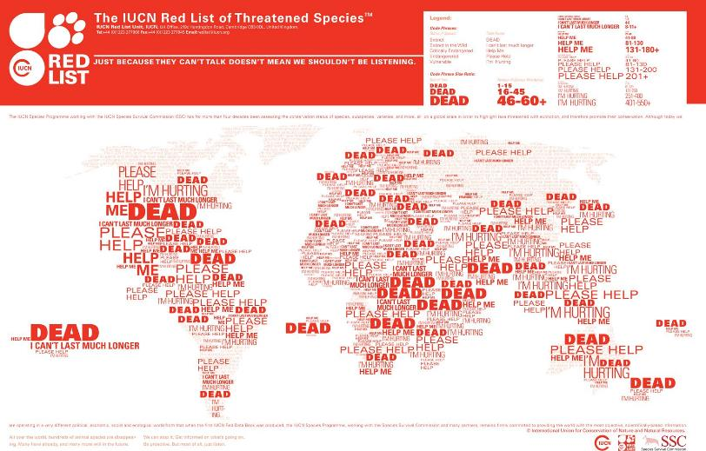
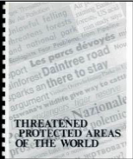
Extinction
Threat
Zero
Doom
Last Chance
Degradation
Destruction
Downgrading
Loss
Critical
Endangered
Vulnerable
Abuses
Isolation
Invasive

Slide 3



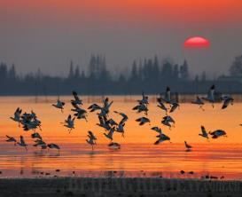
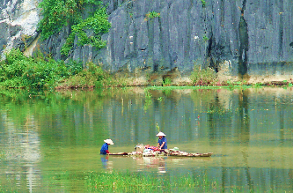
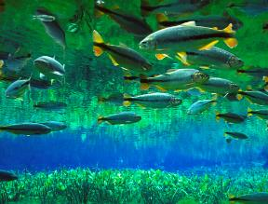
Solutions-based approach
Transform the ‘crisis narrative’ into a solutions dialogue
Identify priorities
Work together to find solutions
Achieve success for people and nature

Slide 4
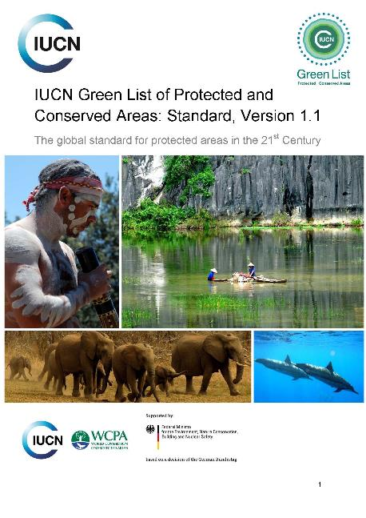
New Global Standard
Good Governance
Sound Design and Planning
Effective Management
Conservation Outcomes
Notes:
At the heart of the green list is a standard. This standard is a sustainability standard, designed in a similar way to the Forest stewardship Council, or the Marine stewardship Council. That is to say the standard is used to actively improve practice and performance.
The standard describes in very simple terms all the ingredients for a successful nature conservation area. It describes in just a few criteria how to achieve results, at the pathway to get there.
The global standard was formally adopted by IUC N Council in November 2017. The standard itself was developed through global input and consultation.

Slide 5

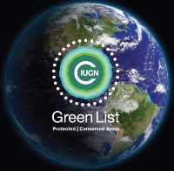
Green List Standard
COMPONENTS
Three central elements to area-based conservation
Combined, these deliver successful conservation outcomes
CRITERIA
17 criteria that describe success
Globallly consistent
INDICATORS
50 generic indicators
Adaptable to a regional or national context

Slide 6
1.1 Guarantee legitimacy and voice
1.2 Achieve transparency and accountability
1.3 Enable governance vitality and capacity to respond adaptively
2.1 Identify major site values
2.2 Design for long-term conservation
2.3 Understand threats and challenges
2.4 Understand social and economic context
3.1 Long-term management plan
3.2 Manage ecological conditions
3.3 Manage within social and economic context
3.4 Manage threats
3.5 Effectively enforce laws
3.6 Manage access and use
3.7 Measure success
4.1 Demonstrate conservation of major natural values
4.2 Demonstrate conservation of ecosystem services
4.3 Demonstrate conservation of major cultural values

Slide 7
Engage
Diagnose
Invest
Evaluate
Reward

Slide 8

GREEN LIST METRICS
DATA DEFICIENT
LIMITED ALIGNMENT
PARTIALLY MEETS
FULLY MEETS
EXCEEDS
ASSESSMENTS (IMET, METT + PAGE) EVALUATION & EVIDENCE
INDEPENDENT VERIFICATION
INVESTMENT IN PERFORMANCE
IUCN GREEN LIST STANDARD

Slide 9
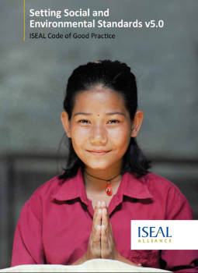
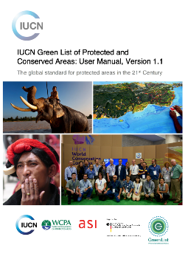
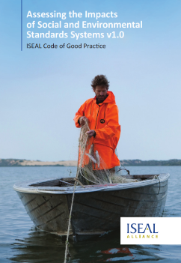

ASSURANCE
ISEAL Codes of Practice
Accreditation Services International (ASI)
Independent Reviewer assigned to each jurisdiction
Compatibility with other programmes (FSC, Blue Flag, GSTC)
Notes:
Assurance is very important to the Green List. It provides credibility and transparency to the process. The IUCN Green List process is based on international codes of best practice in standard setting and certification. All the independent review of the Green List process is carried out by ASI, IUCN’s assurance provider.

Slide 10

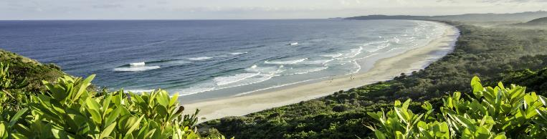
‘Candidate’ for efforts
Good Governance
Sound Design and Planning
Effective Management
Candidates work towards meeting all performance criteria

Slide 11

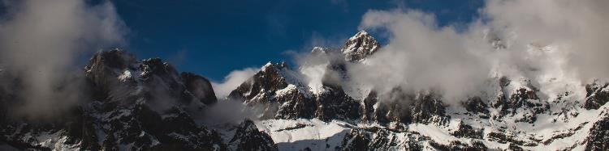
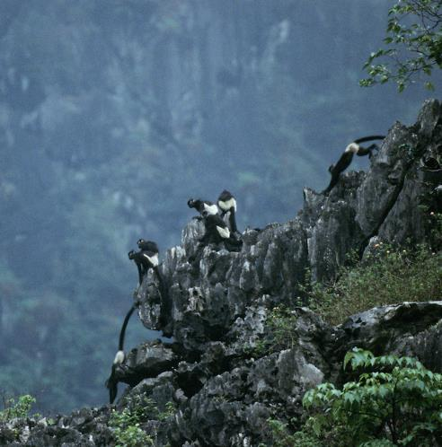
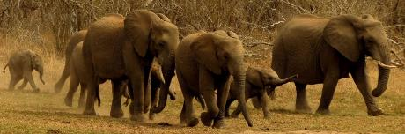

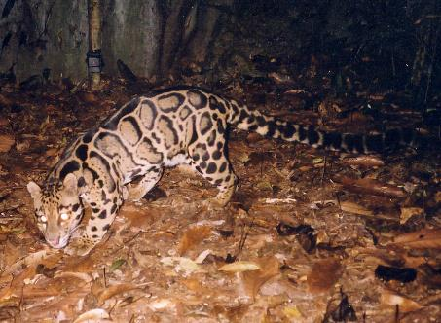
‘Green List’ for results

Slide 12

Reward success
VISIBILITY
INCENTIVES
INSPIRATION

Slide 13

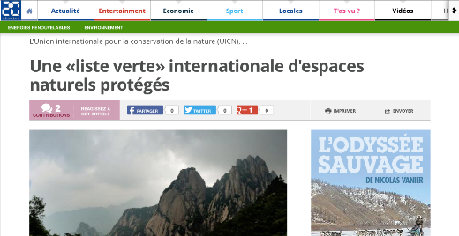

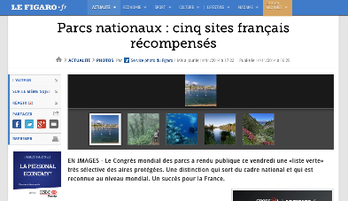
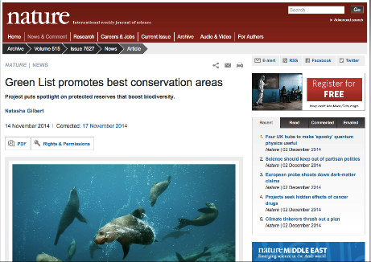
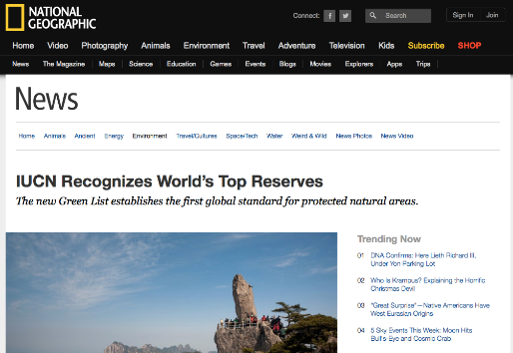
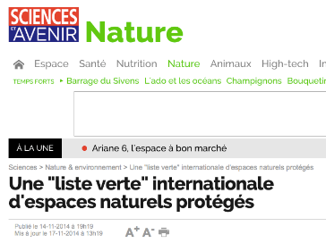
450+ CANDIDATES
48 GREEN LIST

Slide 14
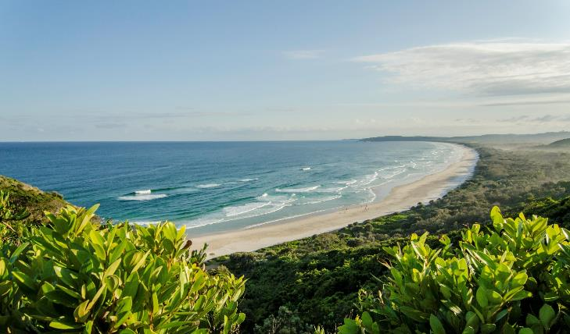
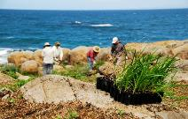
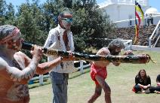
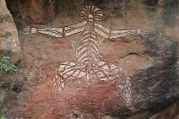
IUCN Green List AUSTRALIA
AUSTRALIA
Arakwal National Park – Cape Byron State Conservation Area
Lamington National Park

Slide 15
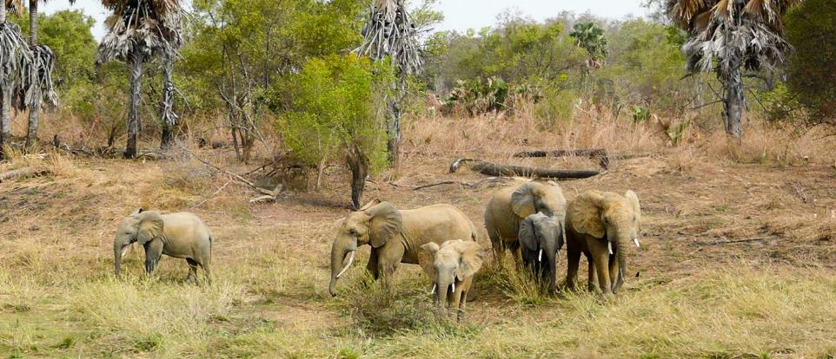
IUCN Green List BENIN
BENIN
Pendjari National Park

Slide 16
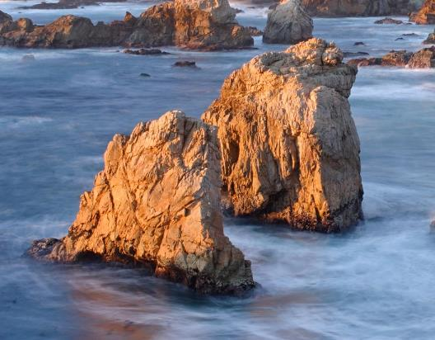
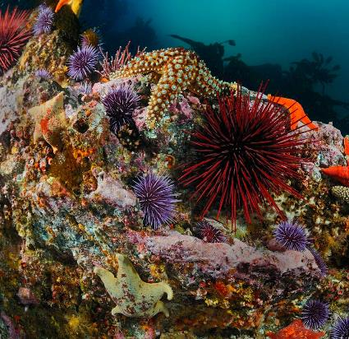
IUCN Green List CALIFORNIA
CALIFORNIA - USA
124 sites as part of the Marine Protected Area Network

Slide 17
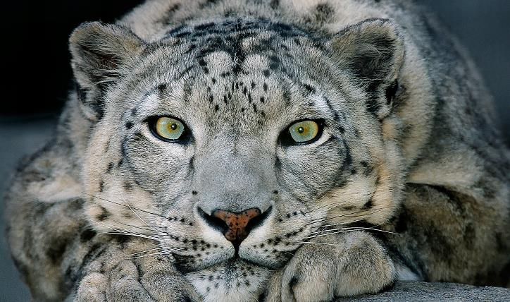
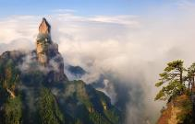
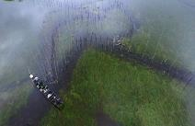

IUCN Green List Jurisdiction 2018
CHINA
Huangshan – Longwanqun – Tangjiahe- East Dongting Lake – Shaaanxi Chanqqing

Slide 18
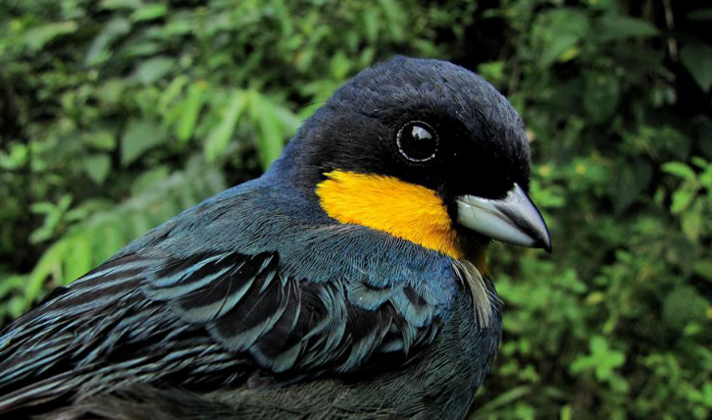
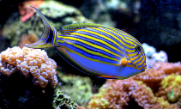
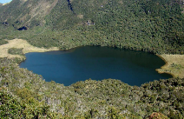
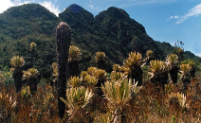
IUCN Green List COLOMBIA
COLOMBIA
Galeras – Tatama – Isla Gorgona
Malpelo - Chingaza

Slide 19
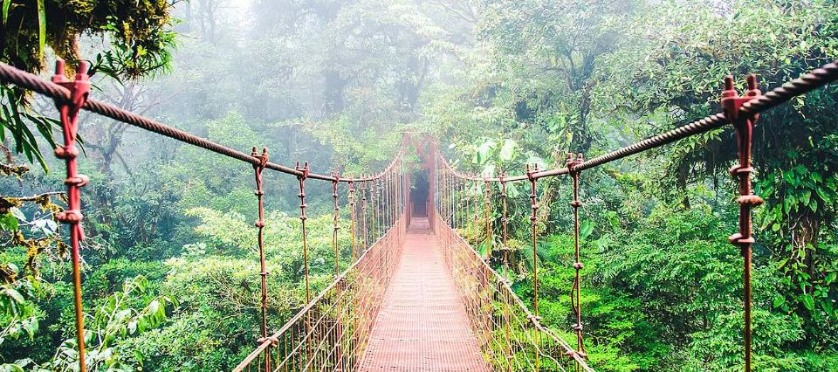
IUCN Green List COSTA RICA
COSTA RICA
New Jurisdiction October 2018 – candidate Monte Verde Cloud Forest Reserve

Slide 20
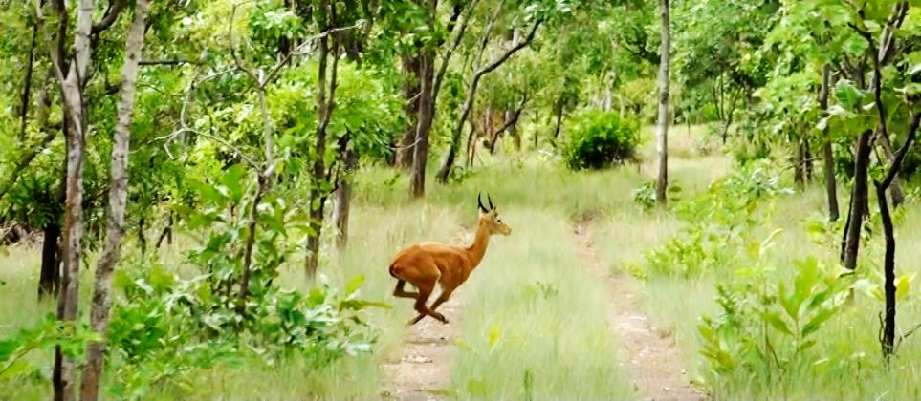
IUCN Green List COTE D’IVOIRE
COTE D’IVOIRE
Comoe National Park

Slide 21
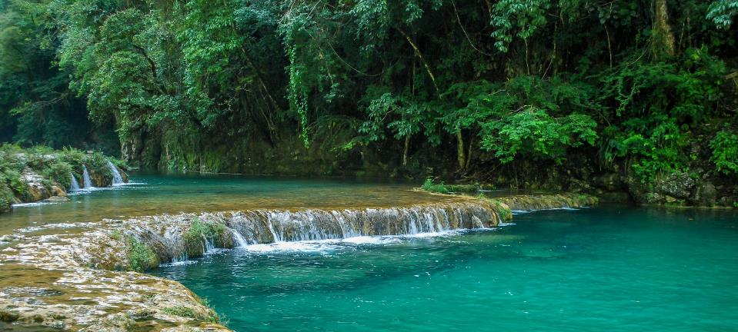
IUCN Green List SELVA MAYA
GUATEMALA
Part of the Selva Maya jurisdiction for 2018

Slide 22
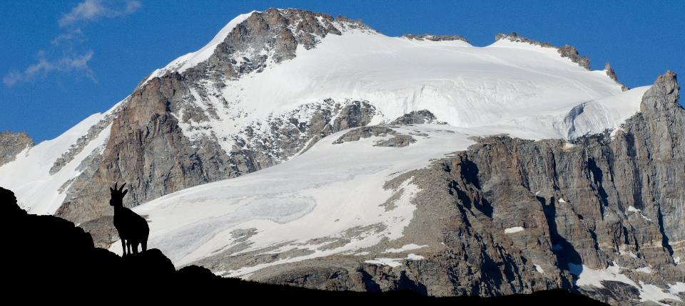
IUCN Green List ITALY
ITALY
Gran Paradiso National Park

Slide 23
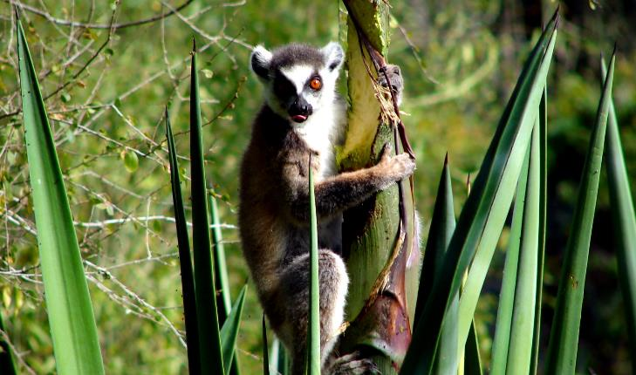
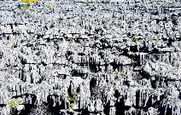
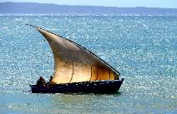
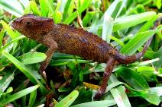
IUCN Green List MADAGASCAR
MADAGASCAR
15 protected areas committed for 2019

Slide 24
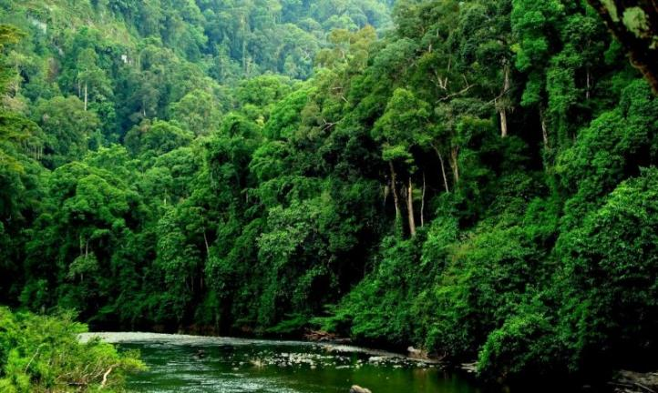
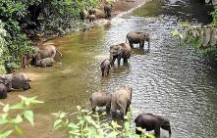
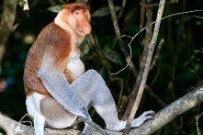
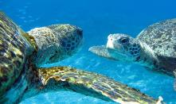
IUCN Green List MALAYSIA (Sabah)
MALAYSIA
Sabah State – Tun Mustafa Marine National Park

Slide 25
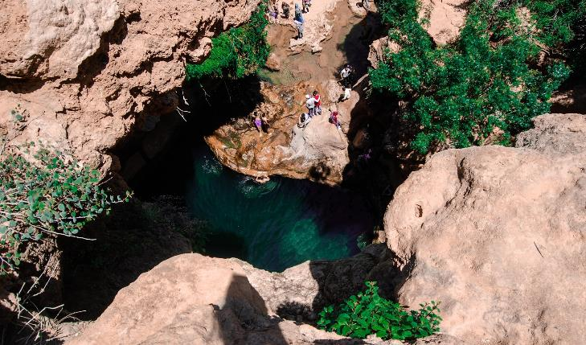
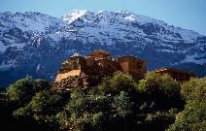

IUCN Green List xxx Jurisdiction 2018
MOROCCO
Ifran National Park – Toubkal National Park

Slide 26


IUCN Green List NIGERIA
NIGERIA
Cross River National Park – Kainji Lake National Park – Old Oyo National Park

Slide 27


IUCN Green List xxx Jurisdiction 2018
PAPUA NEW GUINEA
Feasibility Study underway

Slide 28




IUCN Green List KOREA
REPUBLIC OF KOREA
Odaesan – Seoraksan - Jirisan

Slide 29

IUCN Green List SENEGAL
SENEGAL
New Commitment 2019

Slide 30




IUCN Green List Jurisdiction 2018
SPAIN
Espacio Natural Doñana – Sierra Nevada National Park

Slide 31

IUCN Green List SWITZERLAND
SWITZERLAND
New Jurisdiction – 5 candidates

Slide 32

KENYA: EXTENDED IUCN GREEN LIST SITE
LEWA CONSERVANCY

Slide 33

KENYA: NEW IUCN GREEN LIST SITE 2018
OL KINYEI CONSERVANCY

Slide 34

FRANCE: EXTENDED IUCN GREEN LIST SITE
Parc National de Guadeloupe

Slide 35

FRANCE: NEW IUCN GREEN LIST SITE 2018
Parc marin de la Côte bleue

Slide 36

FRANCE: NEW IUCN GREEN LIST SITE 2018
Réserve Nationale de Chasse et de Faune Sauvage Orlu

Slide 37

FRANCE: NEW IUCN GREEN LIST SITE 2018
Réserve naturelle nationale des Terres australes françaises

Slide 38


PERU: NEW IUCN GREEN LIST SITE 2018
RESERVA COMUNAL AMARAKAERI

Slide 39


PERU: NEW IUCN GREEN LIST SITE 2018
PARQUE NACIONAL CORDILLERA AZUL

Slide 40

IUCN Green List MEXICO
MEXICO
Espiritu Santo Marine National Park – San Martir Archipelago National Park

Slide 41


MEXICO: NEW IUCN GREEN LIST SITE 2018
Parque Nacional Zona marina del Archipiélago de Espíritu Santo

Slide 42


IUCN Green List Middle East and West Asia
STATE OF PALESTINE
Wadi Al-Quff Nature Reserve – Battir Land of Olives and Vines Cultural landscape

Slide 43



LEBANON: NEW IUCN GREEN LIST SITE 2018
Al Shouf Cedars
Nature Reserve

Slide 44

IUCN Green List Middle East and West Asia
JORDAN
Azraq Wetland – Ajloun Forest Reserve
Dana Biosphere Reserve – Royal Botanic Gardens Special Conservation Area

Slide 45


JORDAN
ROYAL BOTANIC GARDENS
‘Conserved Area’ candidate

Slide 46

IUCN Green List Middle East and West Asia
UNITED ARAB EMIRATES
Abu Dhabi – Al Wathba, Mangrove National Park, Marwah
Dubai Desert Conservation Area

Slide 47




EGYPT: NEW IUCN GREEN LIST SITE 2018
WADI AL-HITAN WORLD HERITAGE AREA

Slide 48




EGYPT: NEW IUCN GREEN LIST SITE 2018
RAS MOHAMMED NATIONAL PARK

Slide 49

SEYCHELLES: NEW OPPORTUNITY
Many possible candidates
COUSIN ISLAND Special Reserve

Slide 50





IUCN GREEN LIST
Case Studies for IUCN Standards
Pangolin reintroductions
500% population increase of Delacour ‘s Langur in Van Long Nature Reserve since 2001
Community-based tourism
VIET NAM
Van Long Nature Reserve, Pu Mat National Park

