Slide 1
BIOPAMA Data Management
IMET Data workflow:
from DB to WEB

Slide 2
BIOPAMA Data Management workflow Design
Store: DataBase Infrastructure
Elaborate: Data Management IMET Statistics Views & Functions
Distribute: API JRC Rest Services
Render: Web Applications / Interfaces / Dashboards

Slide 3
The full process schema
WEB
WEB
IMET Online & Offline Tools
Dashboards
[eg. RIS, PAME, …]
Other web applications
Secondary
Servers
Storing
Distributing
Computing
Formatting

Slide 4
Store
Storing IMET Data
Notes:
The divider works as an overlay. To change the images in the background, select the main layer (the top shape) and right click “send to back”. Replace/Change the image. Then click “send to back” on the image you have added.

Slide 5
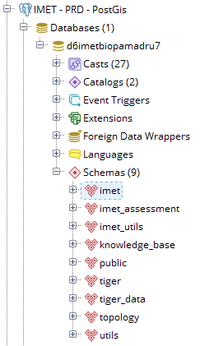
PostgreSQL DataBase
Storing Data into PostgreSQL
also known as Postgres is a free and open-source relational database management system (RDBMS) emphasizing extensibility and technical standards compliance.
IMET Online and Offline tools
store IMET forms (raw data inputs) in several tables in the Global IMET database hosted by JRC servers

Slide 6
Elaborate
Computing IMET Statistics and Indicators
Notes:
The divider works as an overlay. To change the images in the background, select the main layer (the top shape) and right click “send to back”. Replace/Change the image. Then click “send to back” on the image you have added.

Slide 7
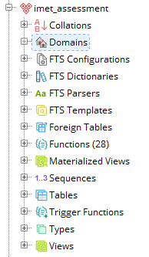
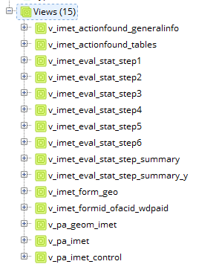
Views and Functions
SQL Views and Functions
SQL scripts compute all main statistics to obtain IMET indicators
Views aggregate data and compute main filters on data
Functions compute statistics and generate APIs for the Rest Services
CREATE OR REPLACE VIEW imet_assessment.v_imet_eval_stat_step_summary AS
WITH table0 AS (
…

Slide 8
Distribute
Generate services to feed different web applications
Notes:
The divider works as an overlay. To change the images in the background, select the main layer (the top shape) and right click “send to back”. Replace/Change the image. Then click “send to back” on the image you have added.

Slide 9
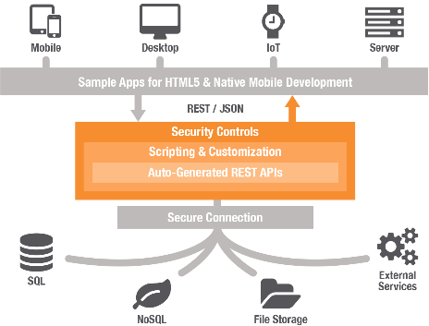
Rest Services Architecture
https://rest-services.jrc.ec.europa.eu
REST
Representational State Transfer is a software architectural style that defines a set of constraints to be used for creating Web services.
JRC REST Server
In a RESTful Web service, requests made to a resource's URI will elicit a response with a payload formatted in HTML, XML, JSON, or some other format.
The response can confirm that some alteration has been made to the stored resource, and the response can provide hypertext links to other related resources or collections of resources.

Slide 10
Render
Consume APIs on different web applications
Notes:
The divider works as an overlay. To change the images in the background, select the main layer (the top shape) and right click “send to back”. Replace/Change the image. Then click “send to back” on the image you have added.

Slide 11
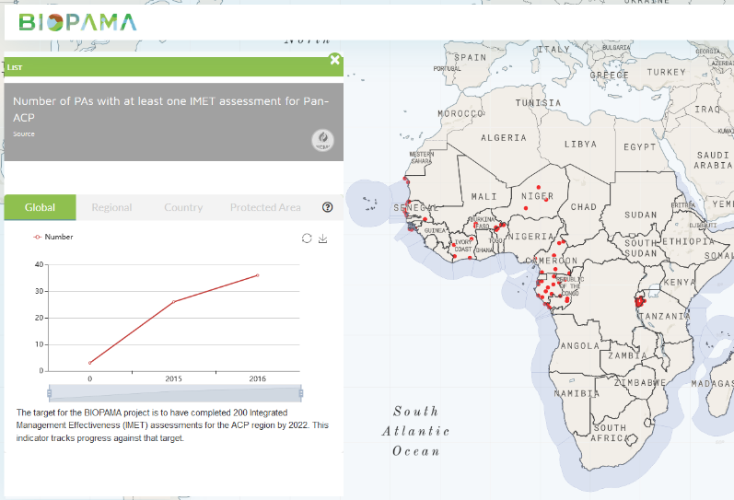
Web Applications, Dashboard, Pages
RIS BIOPAMA
Number of IMET Assessment:the rest function returns the number of PA with wdpaid for a specific ISO3 country or the entire set.

Slide 12
Web Applications, Dashboard, Pages
IMET Management Effectiveness Dashboard (example)
Rest services return the IMET indicators computed based on the raw data, rendered as figures or graphs
Data can be also feed Content Management System (CMS) like Drupal (RIS BIOPAMA)

Slide 13
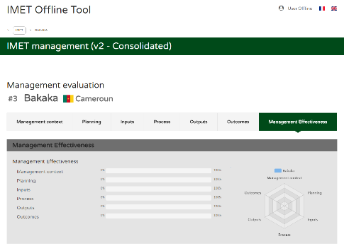
Web Applications, Dashboard, Pages
IMET Management Evaluation Dashboard (example)
Postgres Functions can also feed Content Management System (CMS) like Laravel (Imet Offline & Online Tools) directly

Slide 14
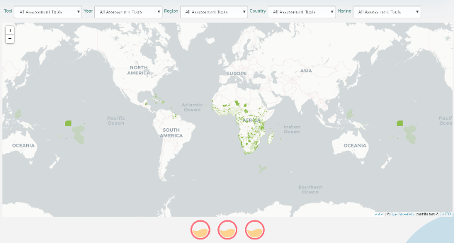
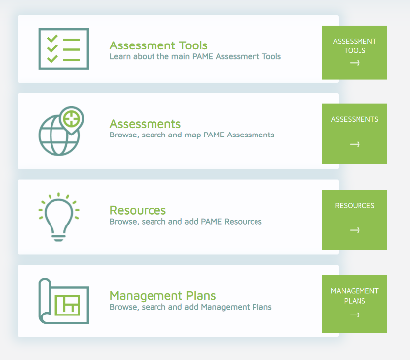
Web Applications, Dashboard, Pages
PAME Module - Assessments
The module provides an overview of the most important PAME assessment tools and the many PAME assessments carried out in the ACP countries (e.g. which tools have been used where and when).

Slide 15
The full process schema
WEB
WEB
IMET Online & Offline Tools
Dashboards
[eg. RIS, PAME, …]
Other web applications
Secondary
Servers
Storing
Distributing
Computing
Formatting

