Slide 1
BIOPAMA IMET TRAINING
Session 5 : ANALYSING IMET ASSESMENT RESULTS
05/02/2020, Kigali, Rwanda
Bertille MAYEN

Slide 2
LEARNING OBJECTIVES OF THE SESSION ANALYSING IMET ASSESMENT RESULTS
At the end of the session, participants will be able to :
Examine the meaning of graphs and histograms in IMET
Identify key aspects for analyzing IMET results
Discuss possible scenario of IMET results
Notes:
The divider works as an overlay. To change the images in the background, select the main layer (the top shape) and right click “send to back”. Replace/Change the image. Then click “send to back” on the image you have added.

Slide 3
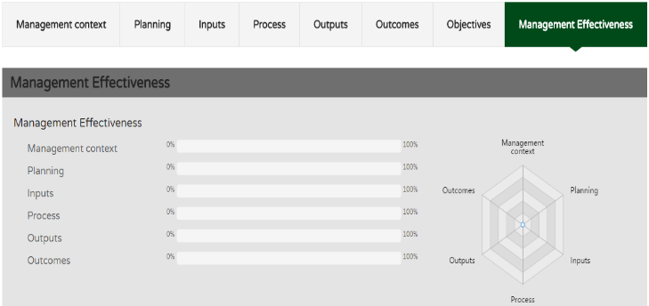
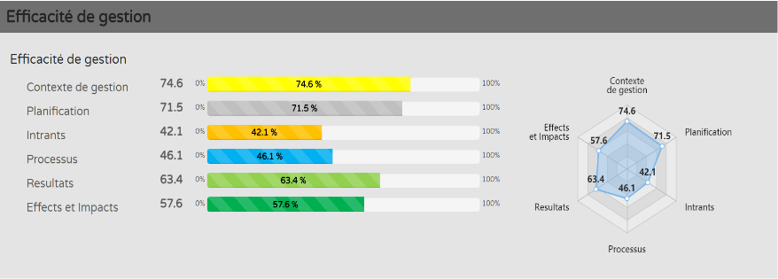
IMET Management Effectiveness Dash Board
At the end of the assessment , the last column of the IMET form provides you a dash board visual effect, where information collected during the exercise are shown
Management effectiveness measures to what extent the outputs of a process led to direct outcomes (effects/impacts) & outcomes contributed to achieving the objective (management objective).
Notes:
The divider works as an overlay. To change the images in the background, select the main layer (the top shape) and right click “send to back”. Replace/Change the image. Then click “send to back” on the image you have added.

Slide 4
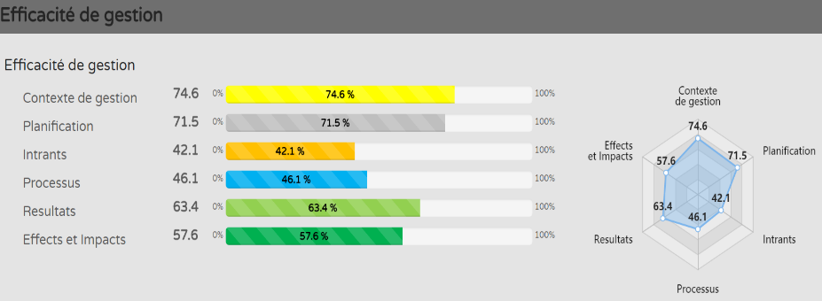
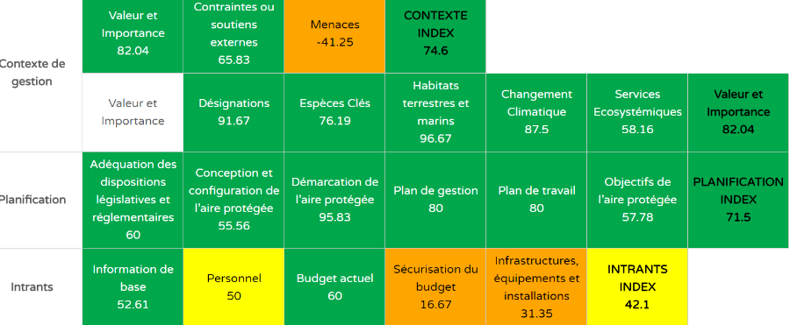
Result is what is achieved by acting toward a defined goal & it
contributes to generating an effect
Results are presented @2 levels:
Global results showing the scores of the 6 PA management cycle;
Specifics scores on each area of assessment
>50%
>34.50%
>33.9%

Slide 5
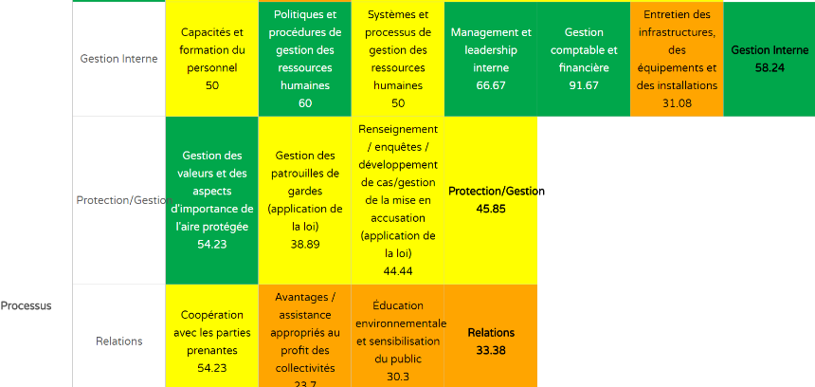
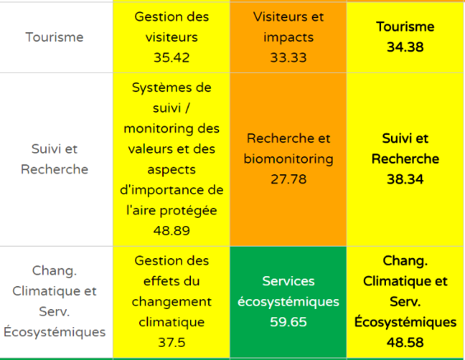
Values defined can be used for the management & monitoring of the PA daily activities, and more specifically for the steps to be taken toward planning, resources mobilization (inputs), process, outputs and outcomes.
it’s important to identify red flags to inform decision makers to cater for arising issues / flows in the management of the PA

Slide 6
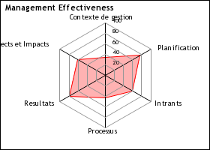
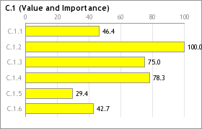
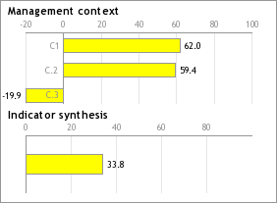
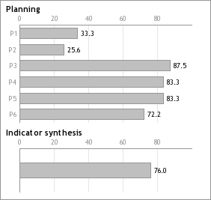
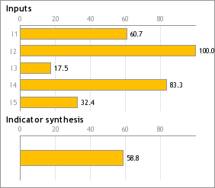
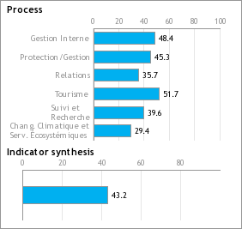
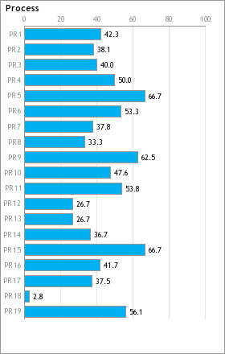
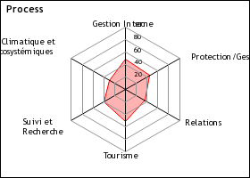
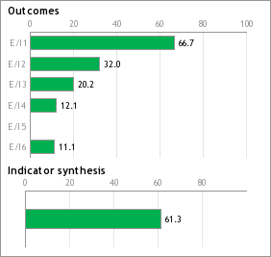
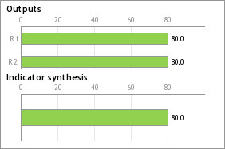
The Management Effectiveness Dash Board allows you to do a:
Rapid assessment/quick overview of 6 elements of the PA management cycle
Visualization, interpretation of the scores generated;
highlight of red flags and a deep dive into understanding the reasons / issues behind the scores;
Cross analysis: differences and similarities between the red flag elements of the PA management cycle

Slide 7
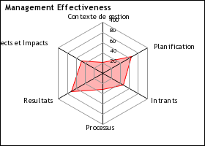
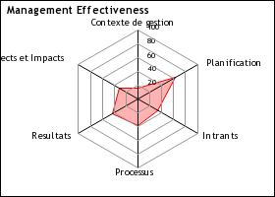
Following Trends and take appropriate measures to improve the PA management is key
2017
2016
2015
Peer Review results to ensure data credibility & stakeholders buy in
Reporting : bridge the gap between data & action;
Policy – advocacy : inform decision makers

Slide 8
DIFFERENT LEVELS OF RESULTS ANALYSIS & PURPOSE
RESULT ANALYSIS
Global analysis based on the data collected & scores
Focus / target user’s analysis for specific needs
Cross analysis for comparison / complimentary purposes
Analysis can also depend on the assessment approach
(IMET integrated or IMET modular approach)
Results @ site level analysis & peer review for the PA manager and stakeholders to define steps to move forward and management objectives to improve management of the PA
Results@landscape level / Regional for partners, regional bodies with the aim of harmonising policies, strategic planning, action plan
Results@ National level / landscape for line ministries, donors, PA mangers & key partners Scaling up for national strategies and policy ; monitoring the PA system

Slide 9
IMET = DISSECTING - STRUCTURING - ANALYSING
Information flow : information & analyzes + knowledge of the status of the ressources & priorities. Dissecting information provided to identify issues for problems solving.
Structuring information to support decision-making in order to better identify problems and formulate the most appropriate conservation actions and strategies
IMET
Analysis
One should pay careful attention to degree of reliability of the information provided (High, Medium or Low).

